Slide 1
Very cool Rootkit | Barnacle Boy
By: Bailey Defino, Bryan Valarezo, Jeffrey Wong, Junming Liu

Slide 2
Project 1 Specifications
Hide specific files and directories from showing up when a user does "ls" and similar commands (you have to come up with a protocol that allows attackers to change these)
Modify the /etc/passwd and /etc/shadow file to add a backdoor account while returning the original contents of the files (pre-attack) when a normal user requests to see the file
Hides specific processes from the process table when a user does a "ps"
Give the ability to a malicious process to elevate its uid to 0 (root) upon demand (again this involves coming up with a protocol for doing that)

Slide 3
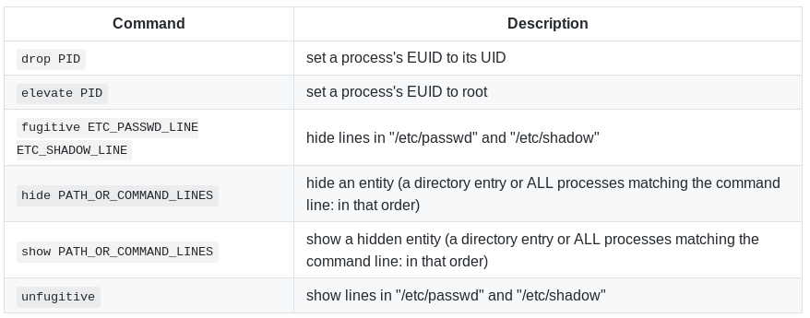
Driver
POSIX shell wrapper script
+ C executable for translating an argument vector into a system call
Driver Quirk | Cause | Workaround
Whitespace in arguments | POSIX shell whitespace handling | Make the system call directly
Hiding a process with a command line which is also a path (the path takes precedence) | Laziness | Make the system call directly

Slide 4
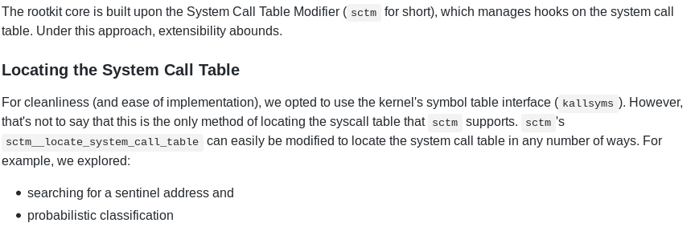
Core

Slide 5
Driver/Core Protocol
Let C be an arbitrary command of known type (a char * in our case)
Let N be our shared system call number with the maximum number of arguments (sys_prctl in our case)
Let M be our shared secret
Core hooks system call N
Driver makes system call N with the following arguments: M, C, [arguments ...]
Core validates M, and if incorrect, defers to the original handler for system call N
Core searches for an appropriate command handler, and if there is none, EINVAL is returned (not -EINVAL, because system calls typically return an unsigned long)
Core passes the arguments to the appropriate command handler, and bubbles a positive version of the return value

Slide 6
File and directory hiding
Commands such as ls and tree makes use of the getdents syscall to obtain directory and file listings.
int getdents(unsigned int fd, struct linux_dirent *dirp, unsigned int count);
Fd is a file descriptor to the directory we want to get the file listing from, dirp is a caller provided pointer for linux_dirents, count is the size of the buffer.
Getdents syscall generates a linked list of linux_dirent structs for the caller to parse.
File/directory hiding is essentially editing the buffer to remove linux_dirent structures from the linked list.
In order to determine what to remove, we check if the file name has a prefix (“3v!1”).

Slide 7
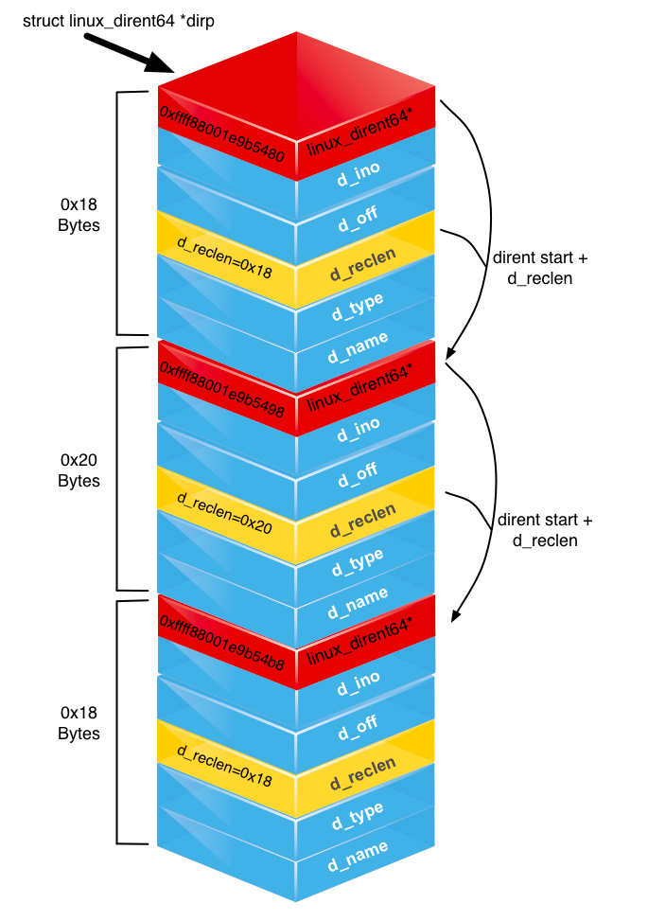
struct linux_dirent {
unsigned long d_ino; /* Inode number */
unsigned long d_off; /* Offset to next linux_dirent */
unsigned short d_reclen; /* Length of this linux_dirent */
char d_name[]; /* Filename (null-terminated) */
/* length is actually (d_reclen - 2 -
offsetof(struct linux_dirent, d_name)) */
/*
char pad; // Zero padding byte
char d_type; // File type (only since Linux
// 2.6.4); offset is (d_reclen - 1)
*/
}

Slide 8
Process hiding
Commands such as ps, top, htop etc. also make use of the getdents syscall except it calls it on the /proc directory.
/proc contains files and directories that detail system information. The most relevant things in /proc are the integer numbered directories which correspond to the PID of a process.
Hiding processes is just the same process as file hiding now except we just need to use the PID to get the command name and check if its a command name that should be hidden.
To determine which dirents we remove we check an arraylist of strings or check if the command name has the prefix “3v!1”.

Slide 9
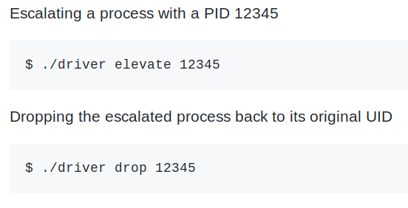
Process Privilege Escalation
In Linux, a process structure is defined by the task_struct.
Escalating processes is done by modifying a task_struct's credentials. This can be accomplished by overwriting the credentials struct within the task_struct.
In the rootkit, we get the task_struct of the process by PID, and we write directly to its credentials.
How it's done in the rootkit:
{
pcred = (struct cred *)task->cred;
...
//Lock the Mutex(Needed to address race conditions)
//Disable Write-Protection(struct is read-only)
...
pcred->uid.val = 0;
pcred->suid.val = 0;
pcred->euid.val = 0;
pcred->fsuid.val = 0;
pcred->gid.val = 0;
pcred->sgid.val = 0;
pcred->egid.val = 0;
pcred->fsgid.val = 0;
...
}

Slide 10
Account Hiding
Control flow:
Hijacks syscall open, close, and write.
When opening and closing /etc/passwd and /etc/shadow, a flag is toggled for write to decide whether to hide buffer content or not.

Slide 11
Distribution of work
Driver, client communication with modules, hooking custom system calls, and consolidation of all functional modules - Bailey Defino
Process privilege escalation - Bryan Valarezo
Process hiding and file hiding - Jeffrey Wong
Backdoor account/hiding users from /etc/shadow and /etc/passwd - Junming Liu

